Slide 1

Supervised Learning
Navya Sri, Medidhi
StudentID: @01413557

Slide 2
Machine Learning:
Machine learning is an application of artificial intelligence that provides systems the ability to automatically learn and improve from experience without being explicitly programmed.

Slide 3
Types of Machine Learning:
Supervised Learning.
Unsupervised Learning.
Reinforcement Learning.

Slide 4
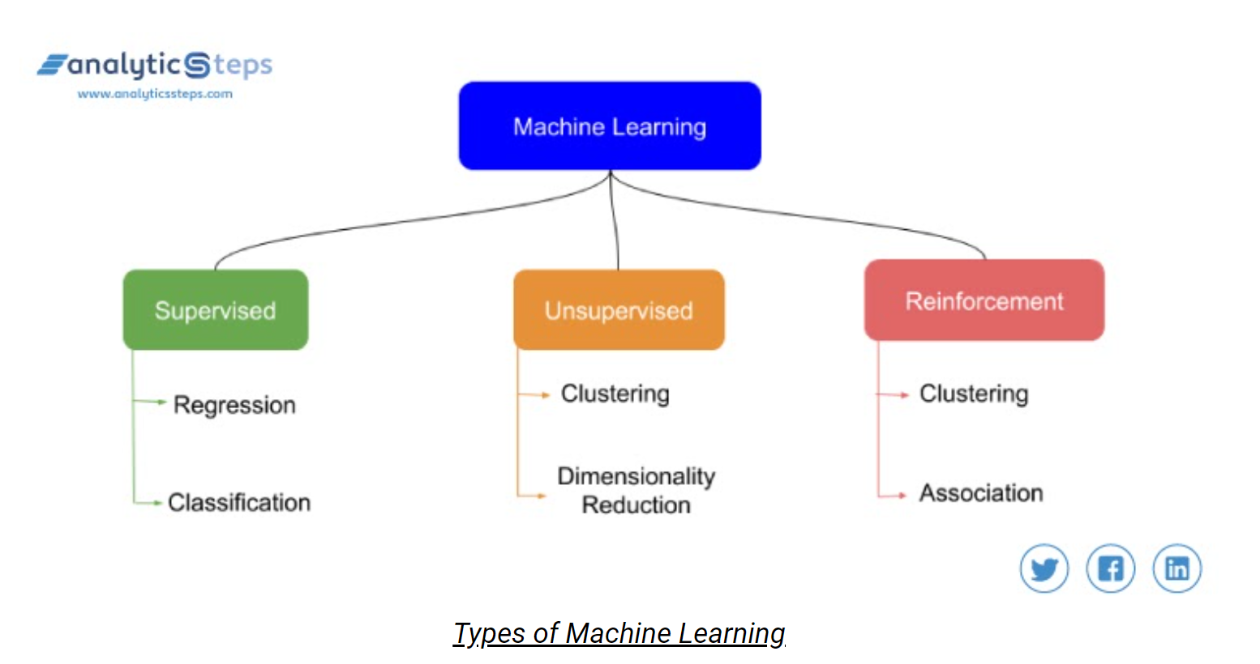

Slide 5
Supervised Learning:
In supervised learning, train the model by using the labelled dataset, which is that the dataset has both raw data and results as well.
By splitting the data into training dataset and test dataset.
Where train dataset is used to train our network whereas the test dataset acts as new data for predicting results or to see the accuracy of our model.

Slide 6
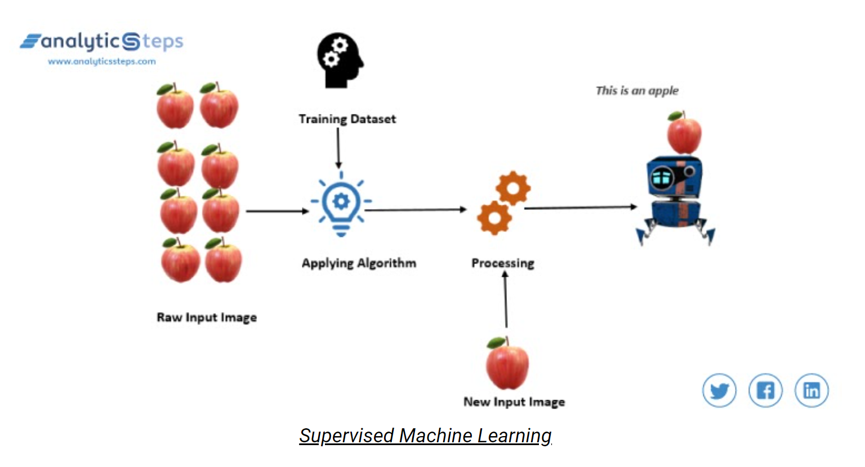

Slide 7
Types of Algorithms for Supervised Learning:
Regression
Classification
Navie Bayesian Model
Random Forest Model
Neural Networks
Support Vector Machines(SVM)

Slide 8
Linear Regression:
Let’s understand Why, What and How in Linear Regression model. Firstly, Why Linear Regression? This regression model draws the relationship between the dependent and independent variables, where dependent variable is otherwise known as predictor variable and independent variable is known as response variable. Now let’s investigate What is Linear Regression? This is a statistical analysis that attempts to show the relationship between two variables. How Linear Regression works? With the data provided by the dataset, we draw a plot between independent and dependent variable and spot a mean value for those values. It selects the best fit line that passes through the mean of the data. But as we know there will be multiple lines that passes through that mean point. To solve this scenario, we move the line until we have least square distance from all the data points. To analyze this technique there few steps, that need to be followed:
Generating inputs using .CSV file.
Importing the libraries.
Splitting the dataset into train and test.
Applying regression on independent variables.
Validating the model.

Slide 9
Applications of Supervised Learning:
Sentiment Analysis: This is a natural language processing technique in which we analyze and categorize some meaning out of the given text data. For example, if we are analyzing tweets of people and want to predict whether a tweet is a query, complaint, suggestion, opinion or news, we will simply use Sentiment Analysis

Slide 10
Recommendations: Every e-Commerce site or media, all of them use the recommendation system to recommend their products and new releases to their customers or users on the basis of their activities. Netflix, Amazon, Youtube, Flipkart are earning huge profits with the help of their recommendation system.

Slide 11
Spam Filtration: detecting spam emails is indeed a very helpful tool, this filtration techniques can easily detect any sort of virus, malware or even harmful URLs. In recent studies, it was found that about 56.87 percent of all emails revolving around the internet were spam in March 2017 which was a major drop from April 2014’s 71.1 percent spam share.

Slide 12
References:
https://expertsystem.com/machine-learning-definition/
https://www.analyticssteps.com/blogs/introduction-machine-learning-supervised-and-unsupervised-learning
https://www.youtube.com/watch?v=2Sb1Gvo5si8&ab_channel=Simplilearn

